Slide 1










Hi, JRC Murthy
Logout
Employee Attendance
Database Upload
Employee Attendance
E
Search Employee
Attendance Upload
E
Employee Add/Delete
Select File
Test Results
Upload
Report Generation
FAQ’s
Latest Updates
About Us | Terms of Use | GMP Standards | Privacy Policy
Copyright 2019 Shantha Biotechnics Private Limited – All Rights Reserved
Notes:
<i class="fa fa-lightbulb-o">
.glyphicon-glyphicon-upload
.glyphicon-glyphicon-book

Slide 2
Hi, JRC Murthy
Hi, JRC Murthy
Logout
Logout
E
Database Upload
Course Addition
Employee Attendance
E
Course ID*
Search Employee
Employee Add/Delete
Course Addition Date *
Test Results
Duration*
Report Generation
FAQ’s
Submit
Latest Updates
About Us | Terms of Use | GMP Standards | Privacy Policy
Copyright 2019 Shantha Biotechnics Private Limited – All Rights Reserved

Slide 3


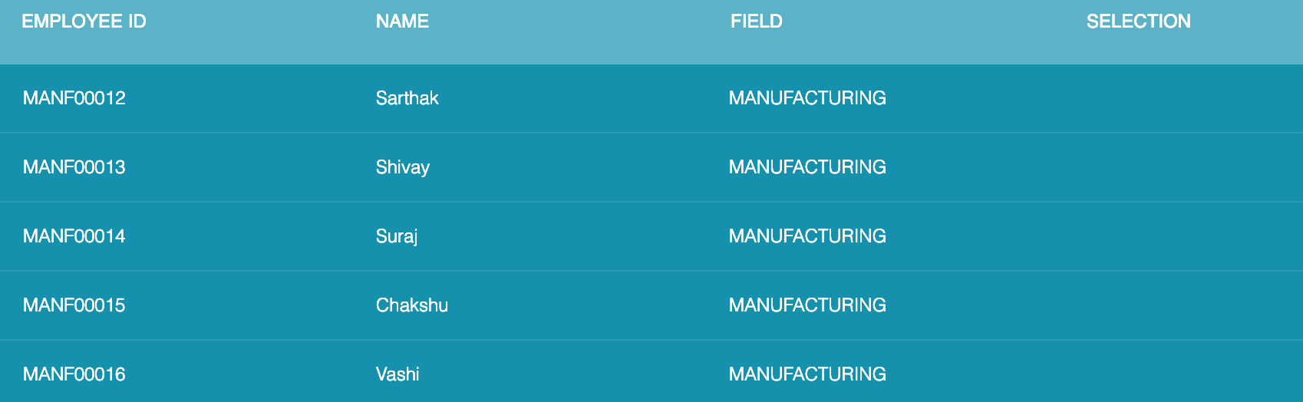

Hi, JRC Murthy
Hi, JRC Murthy
Logout
Logout
E`
Employee Selection
Database Upload
Employee Attendance
Start Date
02/03/2019
Search Employee
Search
Employee ID
Filter
Employee Add/Delete
Test Results
Report Generation
FAQ’s
Latest Updates
Submit
About Us | Terms of Use | GMP Standards | Privacy Policy
Copyright 2019 Shantha Biotechnics Private Limited – All Rights Reserved

Slide 4

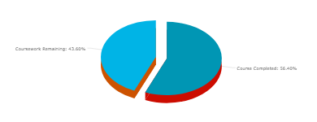
Hi, JRC Murthy
Hi, JRC Murthy
Logout
Logout
Course Work Progress for Trainee
Database Upload
E
Employee Attendance
E
E
Employee ID
FAC00012
Search Employee
Employee Add/Delete
Course ID
Submit
Test Results
E
Report Generation
FAQ’s
Start Date
28/02/19
E
End Date
10/03/19
Latest Updates
Department
MANUFACTURING
About Us | Terms of Use | GMP Standards | Privacy Policy
Copyright 2019 Shantha Biotechnics Private Limited – All Rights Reserved

Slide 5
Hi, JRC Murthy
Hi, JRC Murthy
Logout
Logout
Start Date
-
End Date
Course Work Progress for Trainee
Database Upload
Employee Attendance
E
E
Employee ID
Department
Search Employee
FAC00012
Employee Add/Delete
Course ID
Test Results
Report Generation
Submit
28/02/19 - 10/03/19
FAQ’s
10/03/19
MANUFACTURING
Latest Updates
MANUFACTURING
28/02/19 - 10/03/19
About Us | Terms of Use | GMP Standards | Privacy Policy
E
Copyright 2019 Shantha Biotechnics Private Limited – All Rights Reserved
E
E

Slide 6
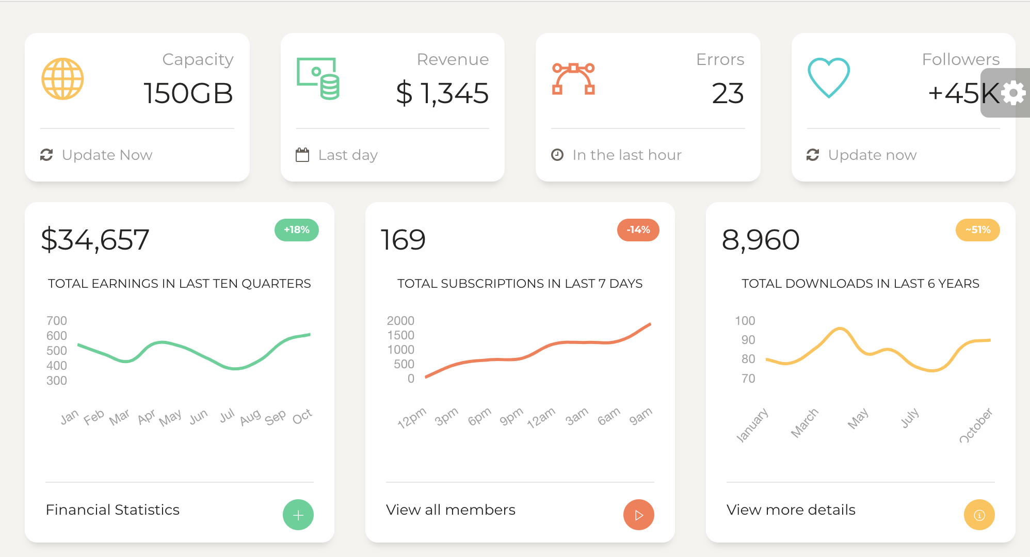
Hi, JRC Murthy
Hi, JRC Murthy
Logout
Logout
Generate New Batch
Database Upload
Employee Attendance
Search Employee
Employee Add/Delete
Test Results
Report Generation
FAQ’s
Latest Updates
About Us | Terms of Use | GMP Standards | Privacy Policy
Copyright 2019 Shantha Biotechnics Private Limited – All Rights Reserved

Slide 7
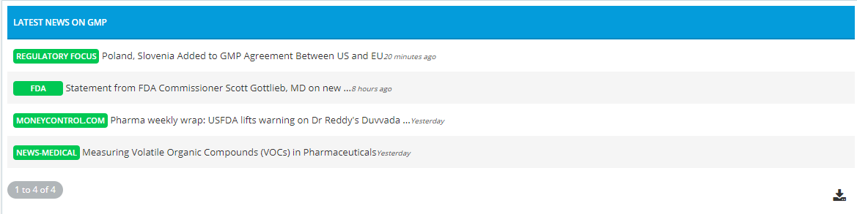
Hi, JRC Murthy
Hi, JRC Murthy
Logout
Logout
Latest Updates
Database Upload
Employee Attendance
Search Employee
Employee Add/Delete
Test Results
Report Generation
FAQ’s
Latest Updates
Latest Video Lectures
Latest News
Documentation
About Us | Terms of Use | GMP Standards | Privacy Policy
Copyright 2019 Shantha Biotechnics Private Limited – All Rights Reserved

Slide 8
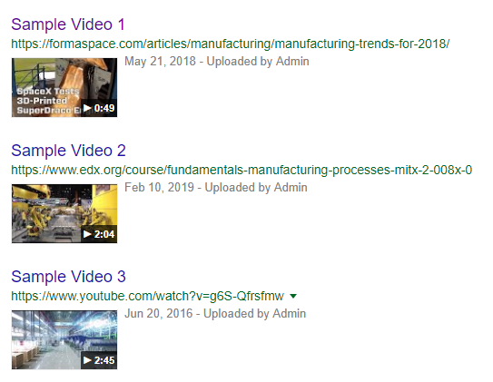
Hi, JRC Murthy
Hi, JRC Murthy
Logout
Logout
Latest Video Lectures : HARDCODE
Database Upload
Employee Attendance
Search Employee
Employee Add/Delete
Test Results
Report Generation
FAQ’s
Latest Updates
Latest Video Lectures
Latest News
Documentation
About Us | Terms of Use | GMP Standards | Privacy Policy
Copyright 2019 Shantha Biotechnics Private Limited – All Rights Reserved

Slide 9
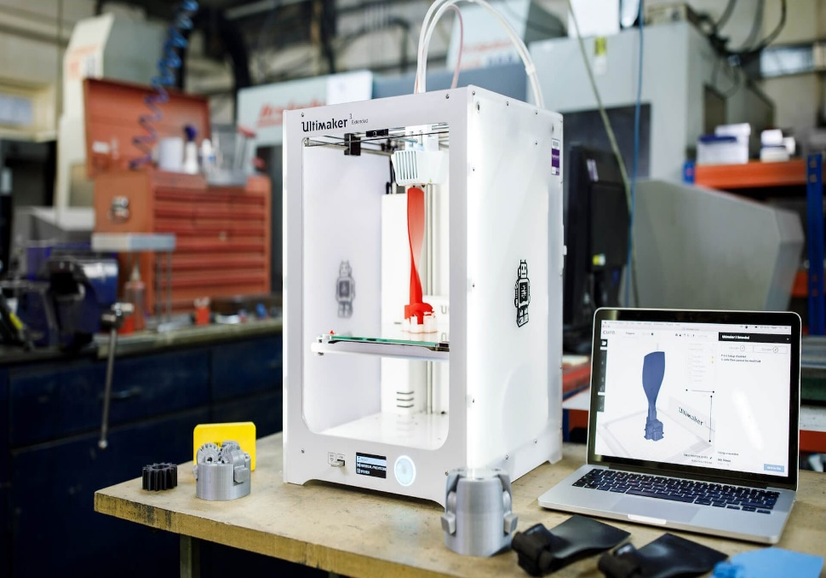
Hi, JRC Murthy
Hi, JRC Murthy
Logout
Logout
Latest Documentation
Database Upload
5 Technologies Now Changing Manufacturing
These technologies are having a disruptive impact on the factories of the future
As new technologies start to pervade all areas of our lives, we are beginning to see their application in the manufacturing industry. The German government coined the term ‘Industry 4.0’ which refers to this revolution of manufacturing through technology. While there is certainly some debate around the use of this term – the integration of production methods with the latest developments in computers certainly has the potential to make manufacturing autonomous, cheaper and more efficient. There are lots of ways this could be done, so what can we expect to see in the factory of the future?
1) Ultrafast 3D printing
Up until now, 3D printing has had limited applications in the manufacture of plastics. Making plastic layer by layer is a time consuming and expensive process compared to traditional techniques like injection moulding. However, Neil Hopkinson of the University of Sheffield has been working on a 3D printing technique which will make it economically viable to mass print plastic objects on a huge scale.
Employee Attendance
Search Employee
Employee Add/Delete
Test Results
Slider
Report Generation
FAQ’s
Latest Updates
Enter Data Here
Submit
Latest Video Lectures
Latest News
Documentation
About Us | Terms of Use | GMP Standards | Privacy Policy
Copyright 2019 Shantha Biotechnics Private Limited – All Rights Reserved

Slide 10
Hi, JRC Murthy
Hi, JRC Murthy
Logout
Logout
Alert Trainee
Database Upload
Employee Attendance
E
E
Employee ID
Search Employee
Employee Add/Delete
E
Course ID
Test Results
Report Generation
E
FAQ’s
Test No.
Latest Updates
Send Email
Send SMS
About Us | Terms of Use | GMP Standards | Privacy Policy
Copyright 2019 Shantha Biotechnics Private Limited – All Rights Reserved

Slide 11
Hi, JRC Murthy
Hi, JRC Murthy
Logout
Logout
Database Upload
Database Upload
Employee Attendance
Employee Attendance
Search Employee
Search Employee
Employee Add/Delete
Employee Add/Delete
Test Results
Test Results
Report Generation
Report Generation
FAQ’s
FAQ’s
Latest Updates
Latest Updates
About Us | Terms of Use | GMP Standards | Privacy Policy
Copyright 2019 Shantha Biotechnics Private Limited – All Rights Reserved

Slide 12



Hi, JRC Murthy
Hi, JRC Murthy
Logout
Logout
Management Tools
Employee
Trainer Account
Course Management
About Us | Terms of Use | GMP Standards | Privacy Policy
Copyright 2019 Shantha Biotechnics Private Limited – All Rights Reserved
Notes:
<span class="glyphicon glyphicon-user"></span>
<i class='fas fa-chalkboard-teacher'></i>
<i class='fas fa-book-open'></i>

Slide 13
Hi, JRC Murthy
Hi, JRC Murthy
Logout
Logout
Management Tools
Employee Addition
Employee
Employee Name
Age
Trainer Account
Date of Birth
Gender
Course Management
Address
Designation
Contact No.
Department
//dropdown
Govt. ID Type
Govt. It No.
Submit
Please fill all the details.
Employee ID : MANF00323 generated!
About Us | Terms of Use | GMP Standards | Privacy Policy
Copyright 2019 Shantha Biotechnics Private Limited – All Rights Reserved
Notes:
<span class="glyphicon glyphicon-user"></span>
<i class='fas fa-chalkboard-teacher'></i>
<i class='fas fa-book-open'></i>

Slide 14
Hi, JRC Murthy
Hi, JRC Murthy
Logout
Logout
Management Tools
Employee Update
Employee
Employee ID
Trainer Account
Course Management
Employee Name
Age
Date of Birth
Gender
Address
Designation
Contact No.
Department
//dropdown
Govt. ID Type
Govt. It No.
Submit
Please fill all the details.
Employee details updated
About Us | Terms of Use | GMP Standards | Privacy Policy
Copyright 2019 Shantha Biotechnics Private Limited – All Rights Reserved
Notes:
<span class="glyphicon glyphicon-user"></span>
<i class='fas fa-chalkboard-teacher'></i>
<i class='fas fa-book-open'></i>

Slide 15
Hi, JRC Murthy
Hi, JRC Murthy
Logout
Logout
Management Tools
Employee Delete
Employee
Trainer Account
Course Management
Employee Name
Get ID
Designation
ID : MANF7263
Department
Employee ID
Delete
Employee deleted from database
About Us | Terms of Use | GMP Standards | Privacy Policy
Copyright 2019 Shantha Biotechnics Private Limited – All Rights Reserved
Notes:
<span class="glyphicon glyphicon-user"></span>
<i class='fas fa-chalkboard-teacher'></i>
<i class='fas fa-book-open'></i>

Slide 16
Hi, JRC Murthy
Hi, JRC Murthy
Logout
Logout
Management Tools
Trainer Account Addition
Employee
Trainer Account
Name
Contact No.
Department
//dropdown
Course Management
Email ID
Password
Submit & Email
Please fill all the details.
Trainer Account successfully generated
TRNR0031 generated
Trainer Account Deletion
Email ID
Delete Account
About Us | Terms of Use | GMP Standards | Privacy Policy
Copyright 2019 Shantha Biotechnics Private Limited – All Rights Reserved
Notes:
<span class="glyphicon glyphicon-user"></span>
<i class='fas fa-chalkboard-teacher'></i>
<i class='fas fa-book-open'></i>

Slide 17
Hi, JRC Murthy
Hi, JRC Murthy
Logout
Logout
Management Tools
Course Addition
Employee
Course Name
Trainer Account
Course Management
Course ID
Trainer ID
Add multiple trainers by using comma ,
Add Course
Course Deletion
Course ID
Course Name
Delete
About Us | Terms of Use | GMP Standards | Privacy Policy
Copyright 2019 Shantha Biotechnics Private Limited – All Rights Reserved
Notes:
<span class="glyphicon glyphicon-user"></span>
<i class='fas fa-chalkboard-teacher'></i>
<i class='fas fa-book-open'></i>

